Slide 1
Print Your Dreams: Exploring the World of 3D Printing
Presentation Task
Batuhan ODÇIKIN
B2-11

Slide 2
Contents
Introduction to 3D Printing
How 3D Printing Works
How 3D Printers Work
Materials Used in 3D Printing
Applications of 3D Printing
Advantages of 3D Printing
Challenges and Limitations of 3D Printing
Future of 3D Printing

Slide 3
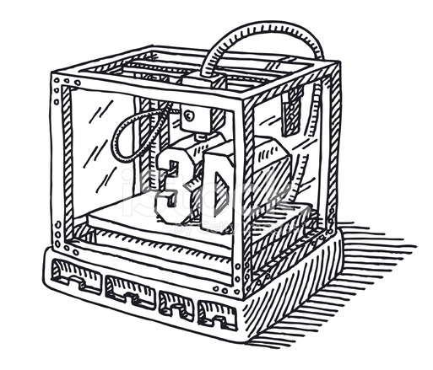
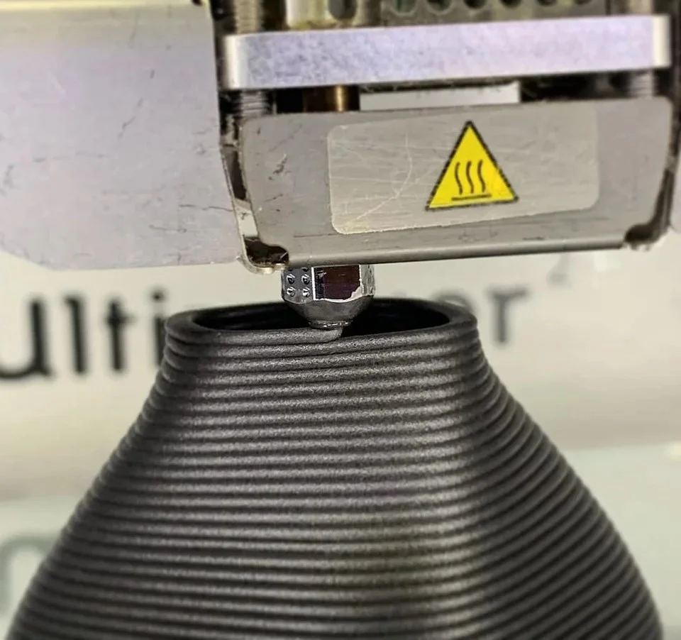
Introduction to 3D Printing
3D printing technology allows to creating three-dimensional objects from digital designs.
Unlike traditional manufacturing ways, 3D printers build objects layer by layer.

Slide 4
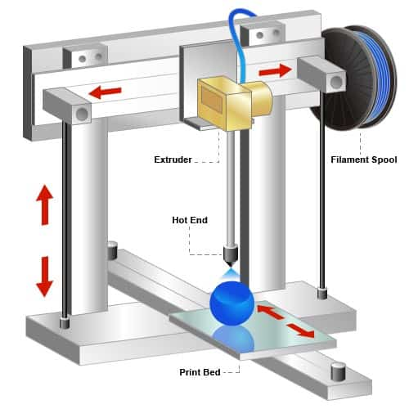
HOW 3D Printers Work
3D printers consist of several main components, including a build platform, an extruder or nozzle, and a control system.
The build platform provides a stable surface on which the object is printed and ensures proper adhesion of each layer.
The extruder or nozzle is responsible for heating and depositing the material onto the build platform according to the instructions from the digital model.
The control system coordinates the movement of the printer's components, controlling the deposition of material and ensuring accurate layering and positioning.

Slide 5
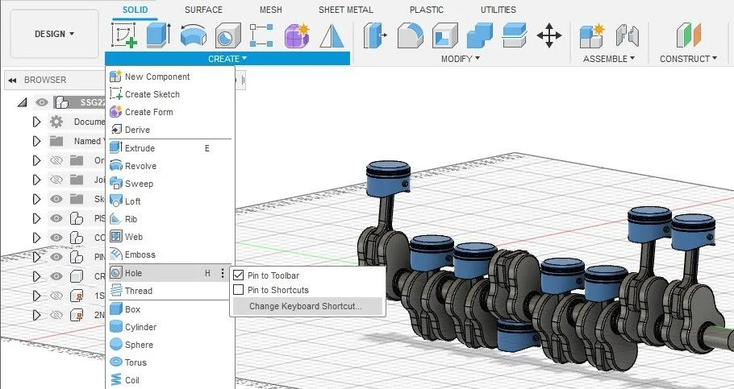
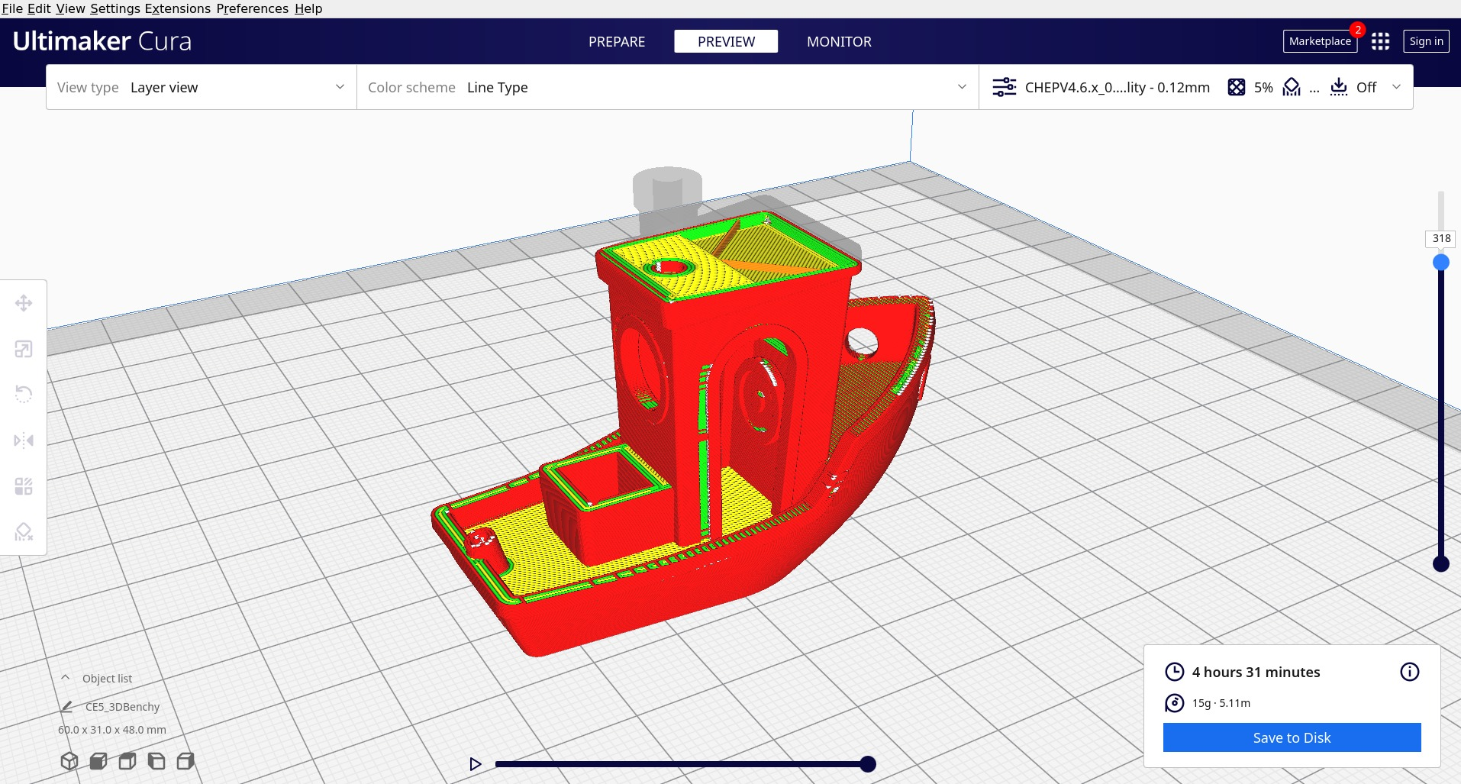
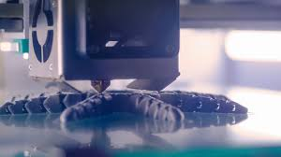
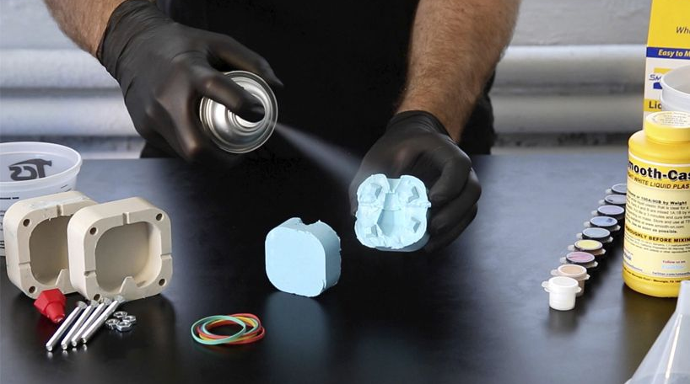
How 3D PrIntIng Works
Design: A 3D model is created using computer-aided design (CAD) software or obtained from an existing digital file.
Slicing: The 3D model is sliced into thin cross-sectional layers.
Printing: The 3D printer reads the sliced model and deposits or solidifies the material layer by layer, following the design specifications.
Post-Processing: Once printing is complete, any necessary finishing touches such as polishing, painting, or assembly are performed.
Four steps of 3D printing

Slide 6
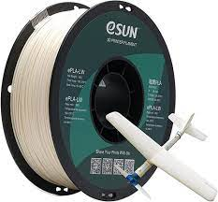
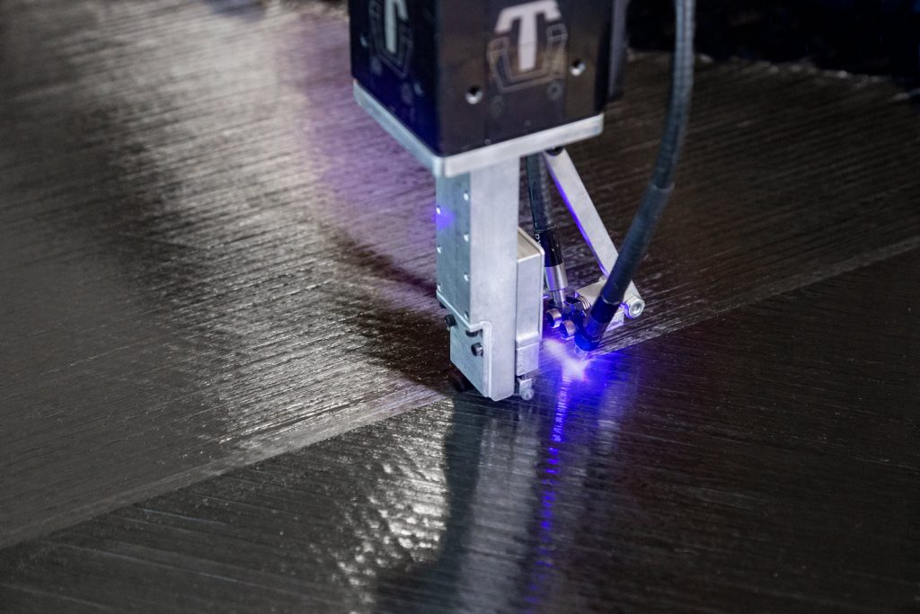
Materials Used in 3D Printing
One of the remarkable aspects of 3D printing is the wide range of materials it can work with. From plastics and metals to ceramics and even food, the possibilities are virtually limitless. Common materials used in 3D printing include:
Plastics: PLA (polylactic acid) and ABS (acrylonitrile butadiene styrene) are widely used for prototyping and consumer applications.
Metals: Aluminum, titanium, stainless steel, and even precious metals like gold and silver can be 3D printed, making it suitable for industries like aerospace or automotive.
Ceramics: Ceramic materials are used in the production of intricate objects like dental implants and artistic sculptures.
Composites: These materials combine different elements, such as carbon fiber-reinforced polymers, to achieve enhanced strength and durability.
Carbon Fiber Printing
(Composite)
PLA (Plastic)

Slide 7
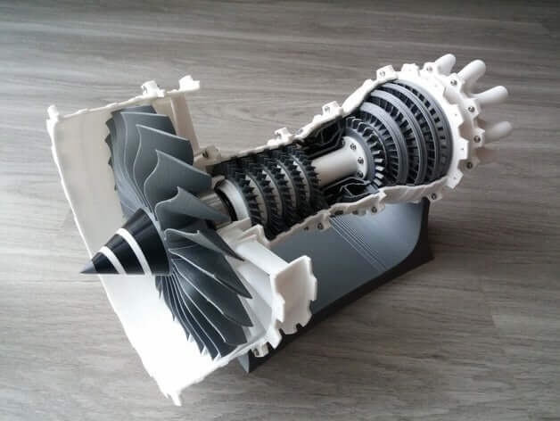
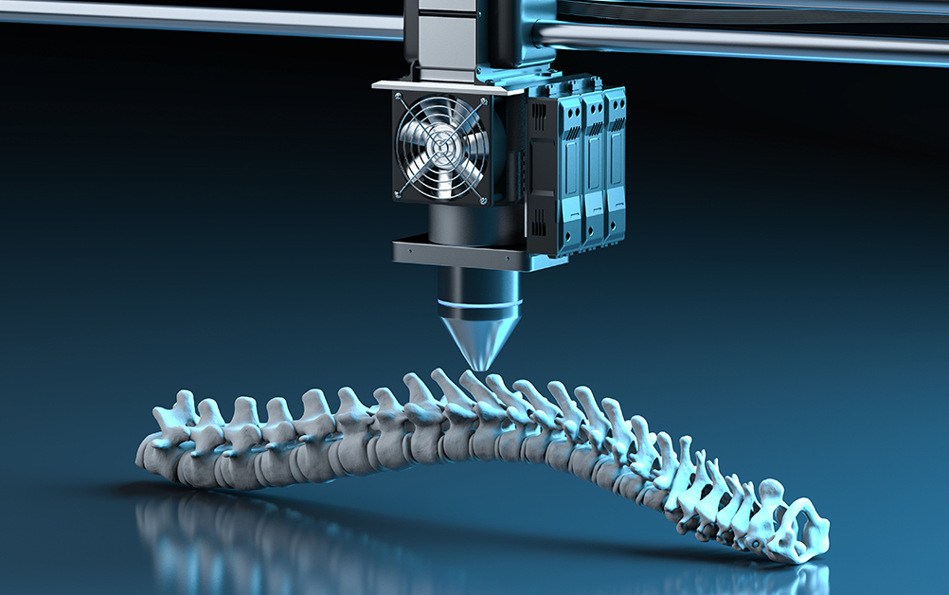
Applications of 3D PrIntIng
3D printing has revolutionized various industries and opened up exciting possibilities. Here are just a few examples of its applications:
Prototyping: 3D printing allows rapid prototyping, enabling designers to quickly iterate and test their ideas before mass production.
Healthcare: It has transformed the medical field, enabling the creation of custom prosthetics, surgical guides, and even organs and tissues.
Automotive and Aerospace: 3D printing is used to produce lightweight components, improve fuel efficiency, and streamline manufacturing processes.
Architecture and Construction: It allows the creation of complex architectural models, customized building components, and even entire houses.
Healthcare applications
3D Prototyping

Slide 8
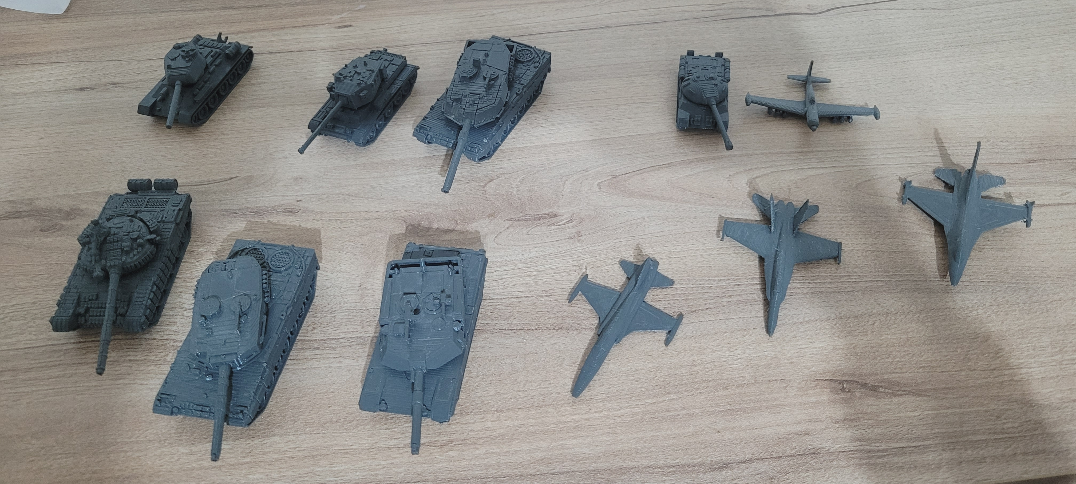
Advantages of 3D PrIntIng
The advantages of 3D printing are numerous and impactful:
Design Flexibility: Complex geometries and intricate details can be easily achieved, opening up new possibilities for creativity.
Cost-Efficiency – Easy Manufacturing: 3D printing eliminates the need for molds or tooling, making it cost-effective for small production runs and customized items.
Rapid Prototyping: It enables quick turnaround times, accelerating the product development cycle.
Customization: Personalized products tailored to individual needs and preferences can be easily created.
Waste Reduction: Traditional manufacturing methods often generate significant material waste, while 3D printing minimizes waste by using only the necessary materials.

Slide 9

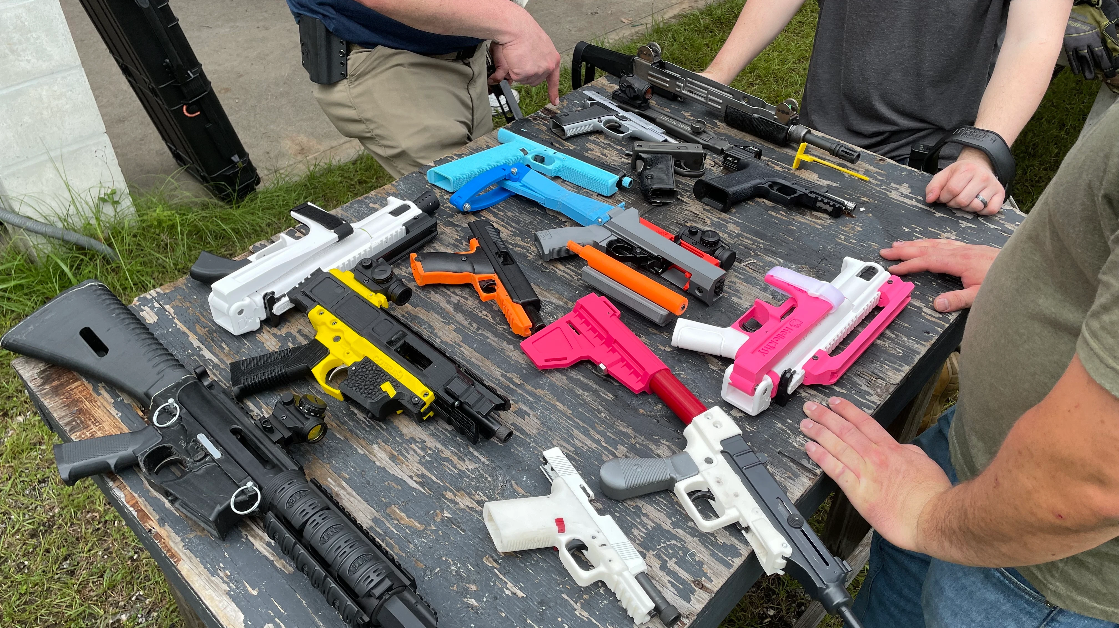
Challenges & Limitations of 3D Printing
Although 3D printing holds enormous potential, it does face some challenges and limitations:
Speed: 3D printing can be a slow process, especially for large or intricate objects.
Size and Scale: There are limitations to the size of objects that can be printed due to the size constraints of 3D printers.
Material Limitations: While the range of printable materials is expanding, not all materials are suitable for 3D printing.
Quality and Durability: Some 3D printed objects may not possess the same level of strength and durability as traditionally manufactured items.
Intellectual Property and Legal Issues: 3D printing raises concerns about copyright infringement and the unauthorized production of patented items.
High Printing Times
3D printed homemade guns

Slide 10
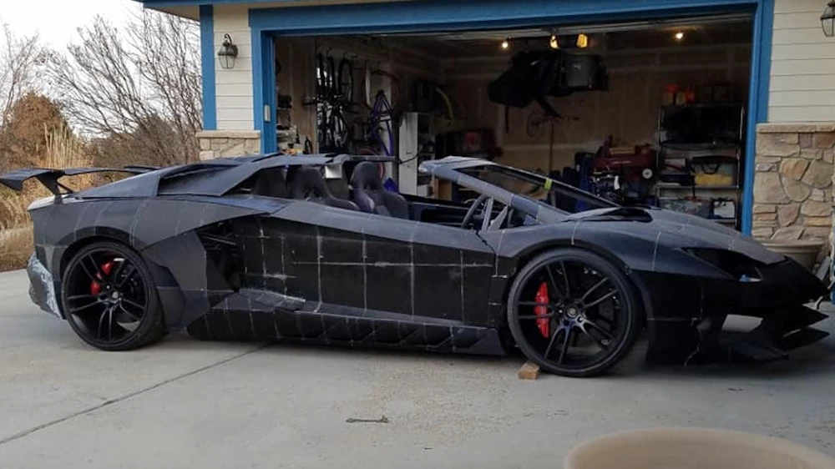
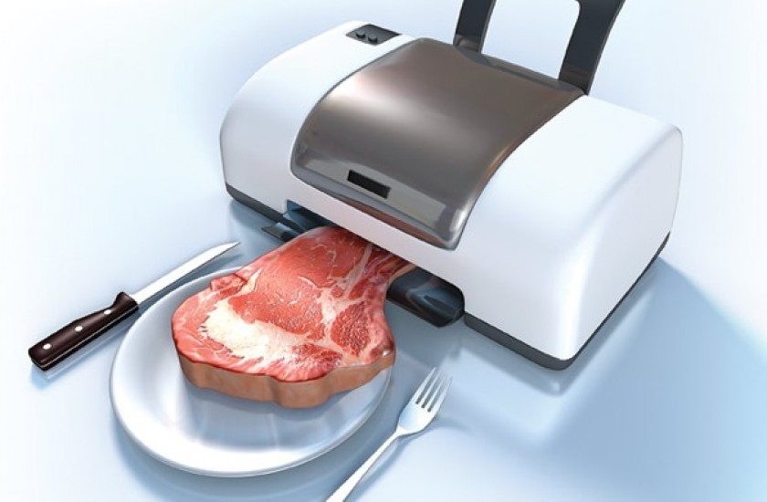
Future of 3D Printing
3D has very big potentional. Like fifteen years ago 3D printing is a very high tech that only a few people can axcess. But today 3D printers comed to our homes and they are usable and reachable for everyone.
Advancements in Materials: Researchers are continuously exploring new materials, such as biocompatible materials for medical applications and conductive materials for electronics.
Large-Scale Printing: As you can see there are a lambo that 3D printed from a 3D printer. Maybe in to the future, we can 3D print and drive our cars. Who knows?
3D printed Lambo

Slide 11
Thanks for listening <3

